Slide 1
Safe Space Crisis Helpline (Hounslow)
Keeley Tickner – Service Manager

Slide 2
Helpline overview
Telephone crisis line that operates during the day and out of hours 11am-11pm, 365 days a year
Aim is to reduce A&E admission and burden on NHS crisis services and offer holistic support
Available for all Hounslow residents 18+
Trained call handlers who have experience in crisis care and knowledge of borough
Receive de-escalation support and advice there and then over the phone
If face to face or further support is required, a referral will be made to sister service - Safe Space

Slide 3
What can a caller expect?
We offer up to 45-60min phone support per session
Unpick the crises and establish a personalised support plan ​
Develop positive coping mechanisms​
Advice ​
A friendly, listening ear​
Signposting to appropriate services ​
Safety planning
To be treated with respect and kindness
Linked in with our crisis alternative service – Safe Space – for longer term support

Slide 4
Case study
Client signposted from our day service Know My Mind
Called helpline during the day as struggling with suicidal thoughts and panic attacks
During the 1hr phone session, we explored safety planning, breathing techniques, coping strategies and devised a weekly schedule
We also referred to Safe Space for further support
Has had two follow up appointments with safe space; exploring DBT coping skills and reinforcing the routine
Has not called helpline since and has not attended A&E

Slide 5
So far…
29 clients have called so far
Majority called for support managing anxiety
Emotional support and breathing techniques have been the used intervention
16 out of 29 clients consented to being referred into Safe Space Community for longer term support
The rest of the clients required only one session from the helpline

Slide 6
Eligibility
18+
Residing or connected to a GP in Hounslow
In or nearing crisis
Carers welcome
Clients can call us directly on: 020 3475 5185 between 11am-11pm
Or email to arrange a call back: crisishelplinehounslow@hfehmind.org.uk

Slide 7
Safe space
We have created a Hub called Safe Space where visitors can come if they are in or nearing a mental health crisis
The space will operate 365 days a year
Core hours are 5pm-10:30pm but we are onsite until 11:30pm
We will offer telephone and virtual appointments too
Can be signposted/referred directing from Helpline
We have a space in every borough
Drop in between 5-7pm:
Southville Community Centre
TW14 8AP
Call us: 0207 471 0584
Or refer via our website: https://www.hfehmind.org.uk/get-support/hounslow-safe-space/

Slide 8
A warm welcome
Cup of tea
Intervention
If you need support, we will look at you as a person, with holistic needs
Follow Up
We will always follow up with you to check how you are
Refreshments
A place to freshen up
Homely, safe environment
A Covid-secure environment
A place to sit and be
A place to talk
We will provide a listening ear
We will help de-escalate your crisis
We will do some planned activities
We will signpost and refer you to other services so you are not left without support
We work with CATT, SPA & MINT if things need to be escalated

Slide 9
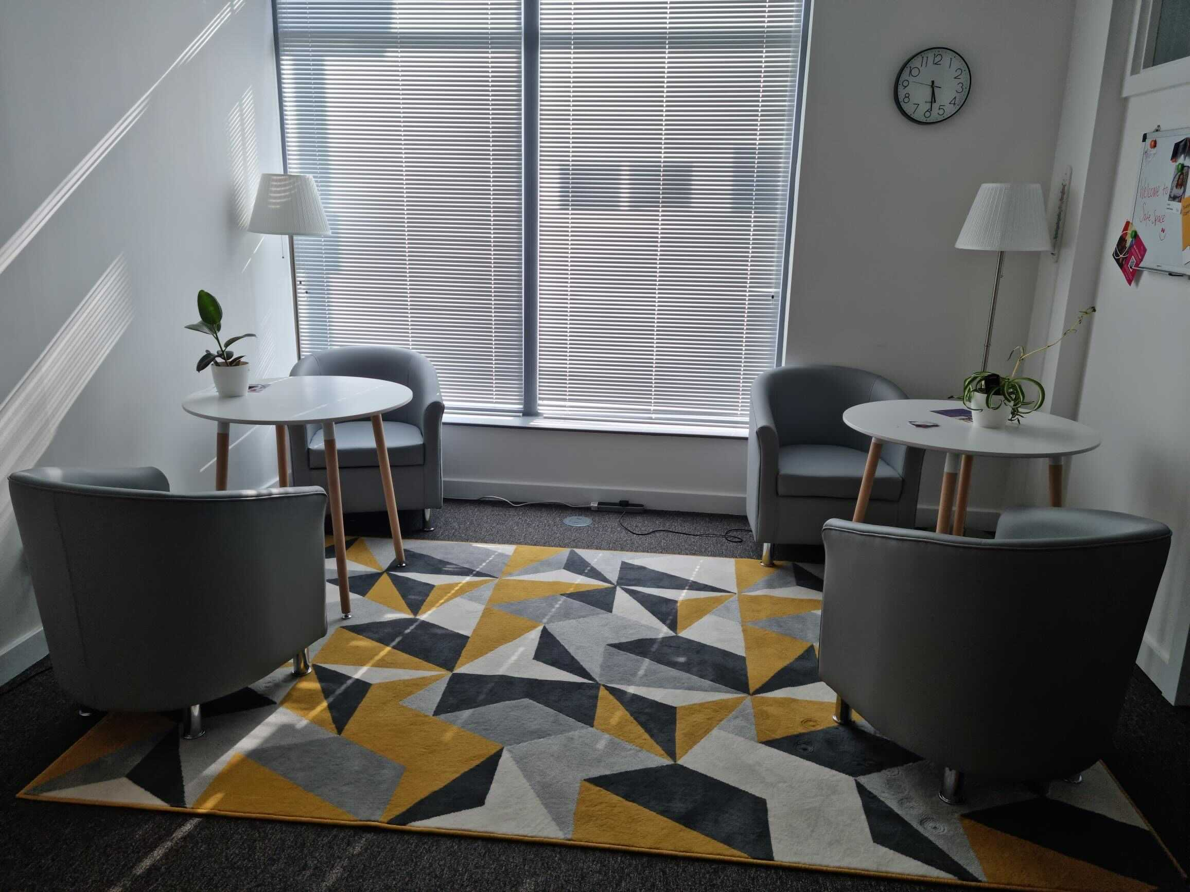
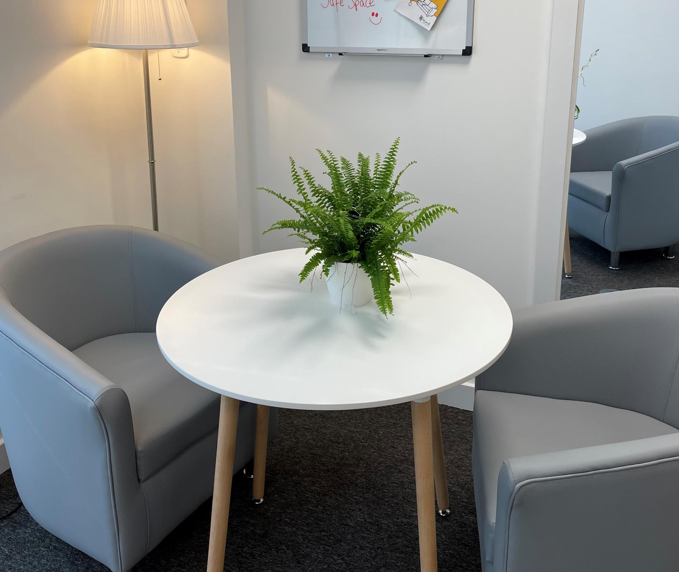
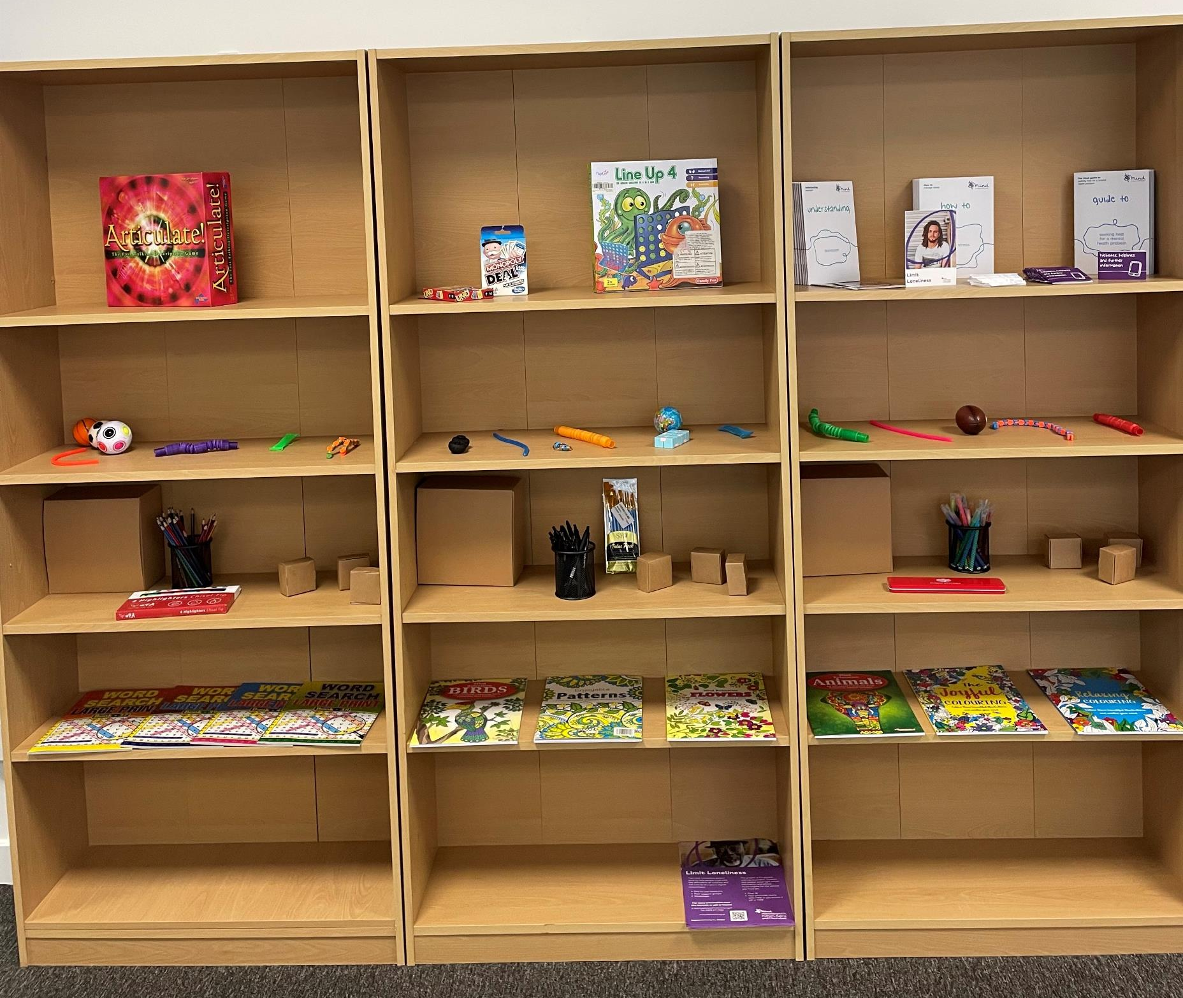
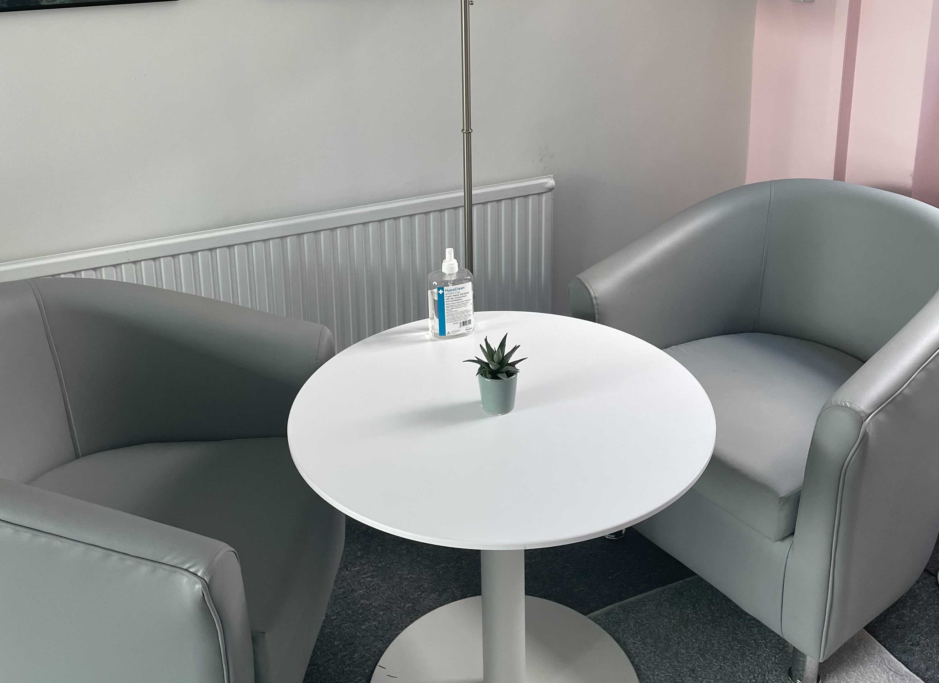
The Space

Slide 10
Safe space during q2…
392 clients supported
1,660 sessions delivered
On average, we support clients between 4-6 sessions
98% clients avoided A&E admission
100% clients recommended the service

Slide 11
How to refer
Helpline: signpost or encourage clients to call 020 3475 5185 between 11am-11pm
Or email to arrange a call back: crisishelplinehounslow@hfehmind.org.uk
Safe Space: Ask a client to visit us during our drop-in hours, 5-7pm at any of our three locations:
H&F – 309 Lillie Road, London, SW6 7LL
Ealing – Lido Centre, 63 Mattock Lane, London, W13 9LA
Hounslow – Southville Community Centre, Southville Road, Feltham, TW14 8AP
Contact us :
H&F - 0207 471 0582 / safespacehf@hfehmind.org.uk
Ealing – 0207 471 0583 / safespaceealing@hfehmind.org.uk
Hounslow – 0207 471 0584 / safespacehounslow@hfehmind.org.uk

